Slide 1
THEORY OF COMPUTATION
Dr.S.Prince Mary M.E.,Ph.D., Associate Professor,
Department of Computer Science and Engineering,
School of Computing
SATHYABAMA
Institute of Science and Technology
Deemed to be University
Chennai.

Slide 2
UNIT- I FINITE AUTOMATA & REGULAR LANGUAGES

Slide 3
Syllabus
Introduction
Regular Languages and Regular Expressions
Deterministic Finite Automata
Non-Deterministic Finite Automata
NFA to DFA Conversion
NFA-NULL Construction
NFA – NULL to NFA Conversion
Kleene’s Theorem Part I & II

Slide 4
What is Theory of Computation or Automata Theory?
It is the study of abstract mathematical machine and it deals with definitions and properties of different types of “computation models”.
Examples of such computational models are:
Finite Automata: text processing, compilers, and hardware design.
Context-Free Grammars: define programming languages and in Artificial Intelligence.
Context-Sensitive Grammars: grammars used for compiler designing and in Artificial intelligence.
Turing Machines: These form a simple abstract model of a “real” computer.

Slide 5
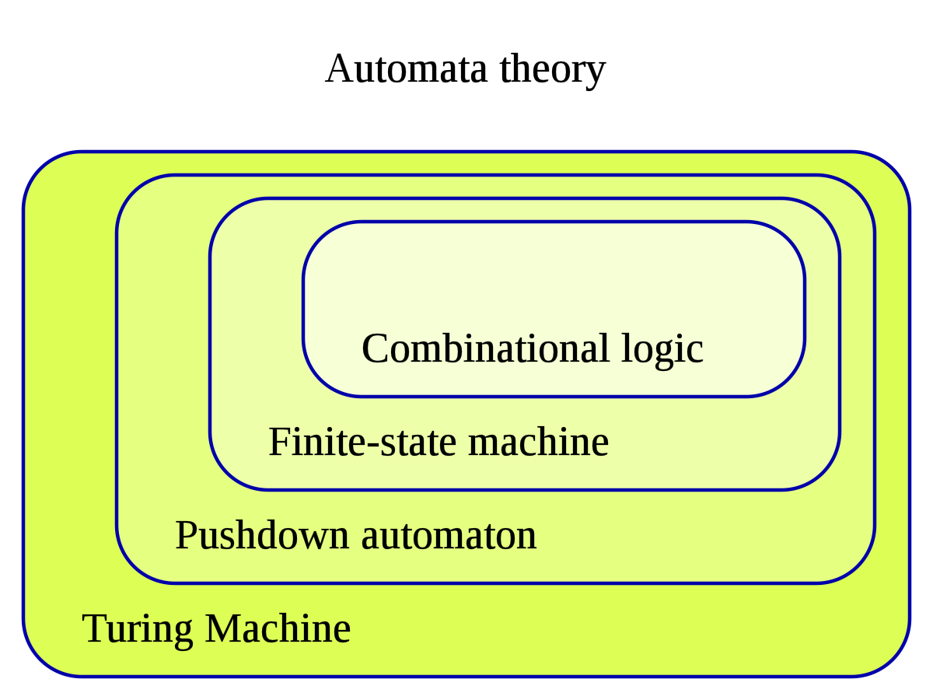

Slide 6
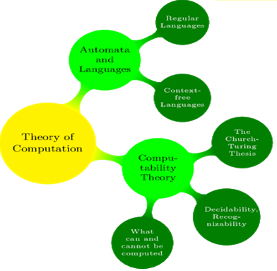
Theory of Computation

Slide 7
Basic Units of Regular Language
Alphabets (∑ ) : {a,b} or {0,1}
String( w) : Collection of input alphabets
Language (L) : Collection of Strings
Empty Set : Ø
NULL String :ε or λ

Slide 8
Finding Language using Conditions
Find L with 0’S and 1’s with odd no. of 1’s
∑ ={ 0,1}
w ={ 1,01,10,100,010, 111,1011……..}
w ={ 1,01,10,100,010, 110 ,111,1011……..} --invalid
L = {w/w consists of odd no. of 1’s}
Find L with 0’s and 1’s with even no. of 1’s
∑ ={ 0,1}
w ={Λ ,11,011,101,110,0110, 1010, ……..}
w ={Λ ,11,011,101,100, 110,0110, 1010, …..} --invalid
L = {w/w consists of even no. of 1’s}

Slide 9
Finding Language using Conditions
Find L with a’s and b’s with even no. of a’s
∑ ={ a,b}
w ={Λ ,aa,baa,aba,aab,baab, abba,abab ……..}
w ={Λ ,aa,baa,aaa,aab,baab, abba,abab ……..} --invalid
L = {w/w consists of even no. of a’s}
Find L with a’s and b’s with even no of a’s and b’s.
∑ ={ a,b}
w ={Λ ,aa,bb,aabb,abab,baba,bbaa ……..}
L = {w/w consists of even no. of a’s and b’s}
Find L with a’s and b’s having a substring aa
∑ ={ a,b}
w ={aa,baa,aab,baab, abaa,aabaa ……..}
L = {w/w consists of a substring aa}

Slide 10
Define Regular language and Regular Expression over ∑.
RL:
A language is regular if there exits a DFA for that language
The language accepted by DFA is RL.
RE:
A Mathematical notation used to describe the regular language.
This is formed by using 3 Symbols:
. [dot operator] – for concatenation
+ [Union operator] –at least 1 occurrence
{*} [Closure Operator ] – Zero or more occurrences

Slide 11
Basic Regular Expressions?
Ø is a RE and denotes the empty set.
ε is a RE and denotes the set { ε }
For each a in ∑, a is a RE and denotes the set {a}
If r and s are RE that denoting the languages R and S respectively, then,
(r+s) is a RE that denotes the set (RUS)
(r.s) is a RE that denotes the set RS
(r)* is a RE that denotes the set R*

Slide 12
Writing Regular Expressions
1. Write RE for the language of even no of 1’s
∑ ={ 1}
w ={Λ , 11,1111, ……..}
RE = (11)*
2. Write RE for the language of odd no of 1’s
∑ ={ 1}
w ={1,111,11111 ……..}
RE = (11)*.1
3. Write RE with a string starting with a
∑ ={ a,b}
w ={a,ab,aba,aab ……..}
RE = (a) (a+b)*

Slide 13
Writing Regular Expressions
4. Write RE with a string starting with either a or ab
∑ ={ a,b}
w ={a,ab,aba,aab ……..}
RE = (a+ab) (a+b)*
5. Write RE with a string consist of a’s and b’s any length include
λ
RE= (a+b)*
6. Write RE with a string a’s and b’s ending with abb
RE= (a+b)*abb
7. Write RE with a string a’s and b’s starting with abb
RE= abb (a+b)*

Slide 14
Writing Regular Expressions
8. Write RE with a string having a substring aa
RE= (a+b)*.aa.(a+b)*
9. Write RE with a string that begins and ends
with double consecutive letters
RE = (aa+bb).(a+b)*.(aa+bb)
10. Strings of a’s and b’s of even length
RE= (aa+bb+ab+ba)*
11. Strings of a’s and b’s in which 3rd symbolfrom right end is a.
RE = (a+b)*.a.(a+b).(a+b)

Slide 15
What is Finite Automata?
Finite automata are used to recognize patterns.
A machine that accepts Regular Language
Applications:
Compliers
Text processing
Hardware design.

Slide 16
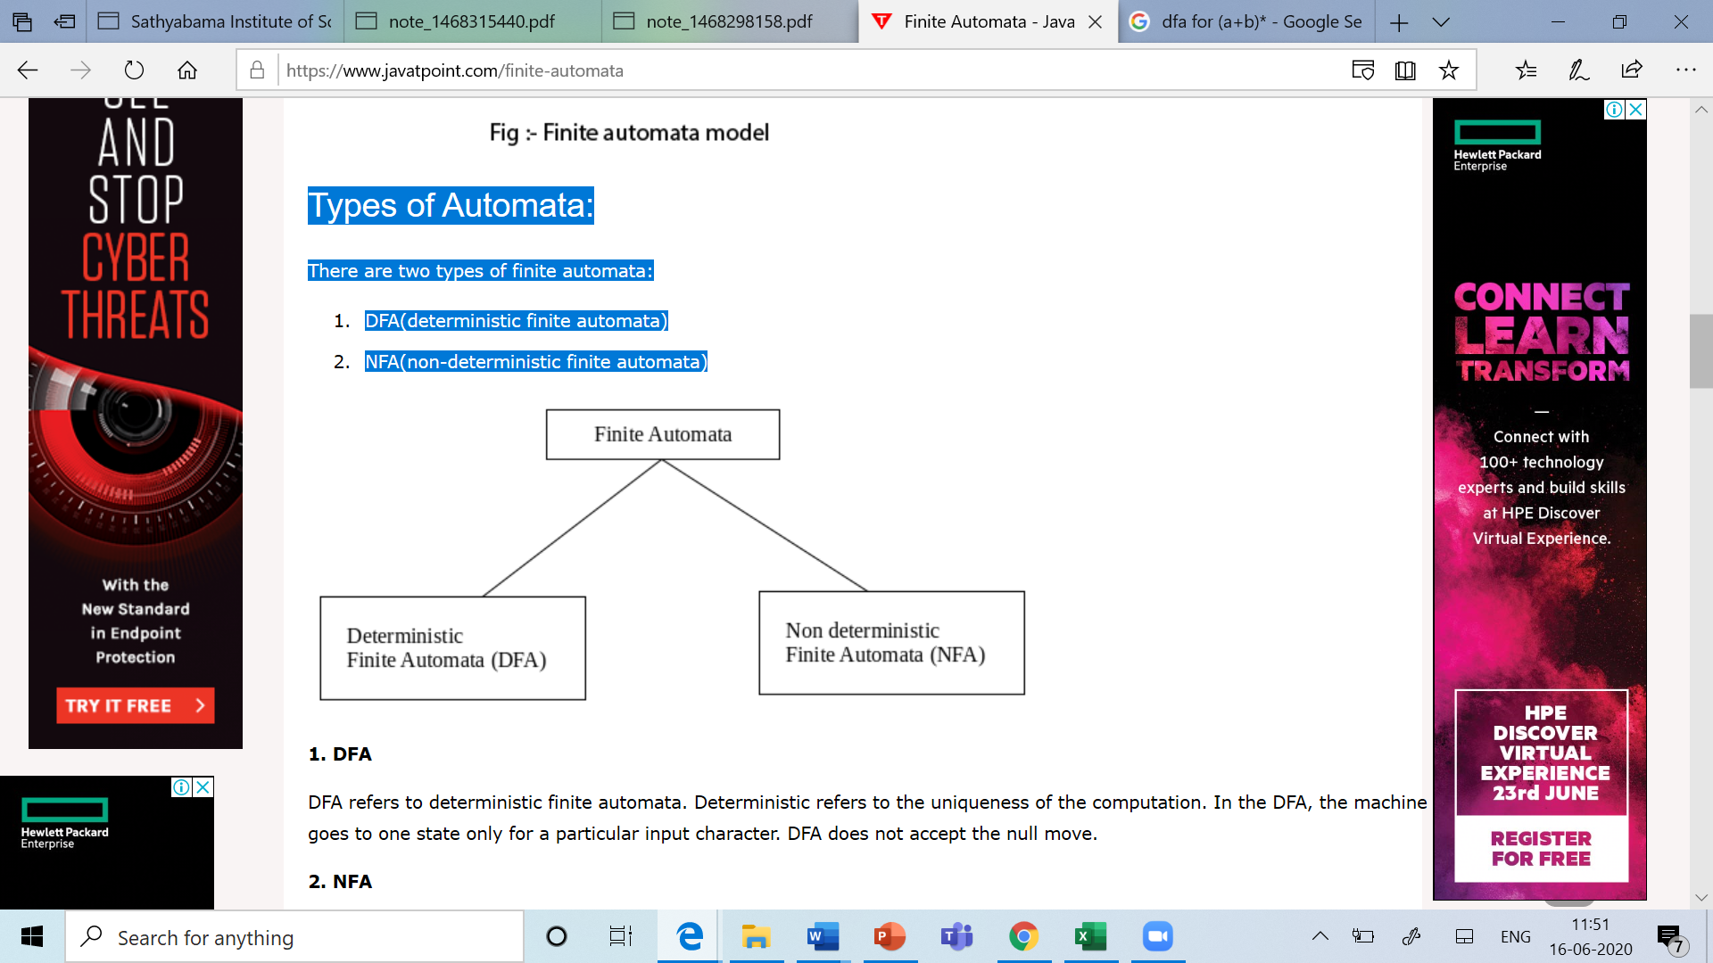
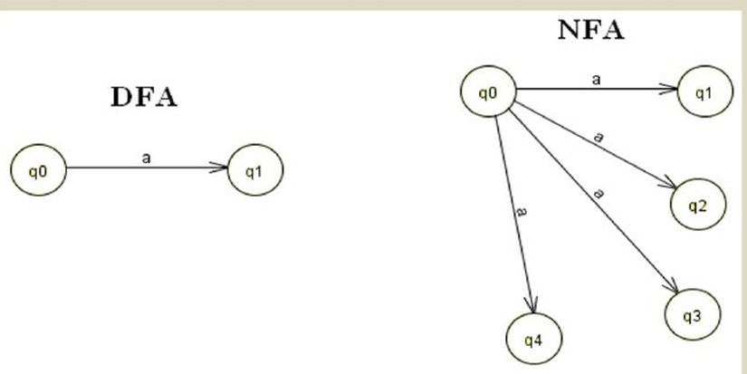
Types of Automata

Slide 17
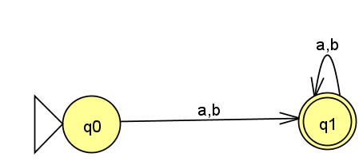
DFA (Deterministic Finite Automata)
Only one path for specific input from the current state to the next state.
DFA does not accept the null move
It is used in Lexical Analysis phase in Compilers.
Example: RE=(a+b)⁺

Slide 18
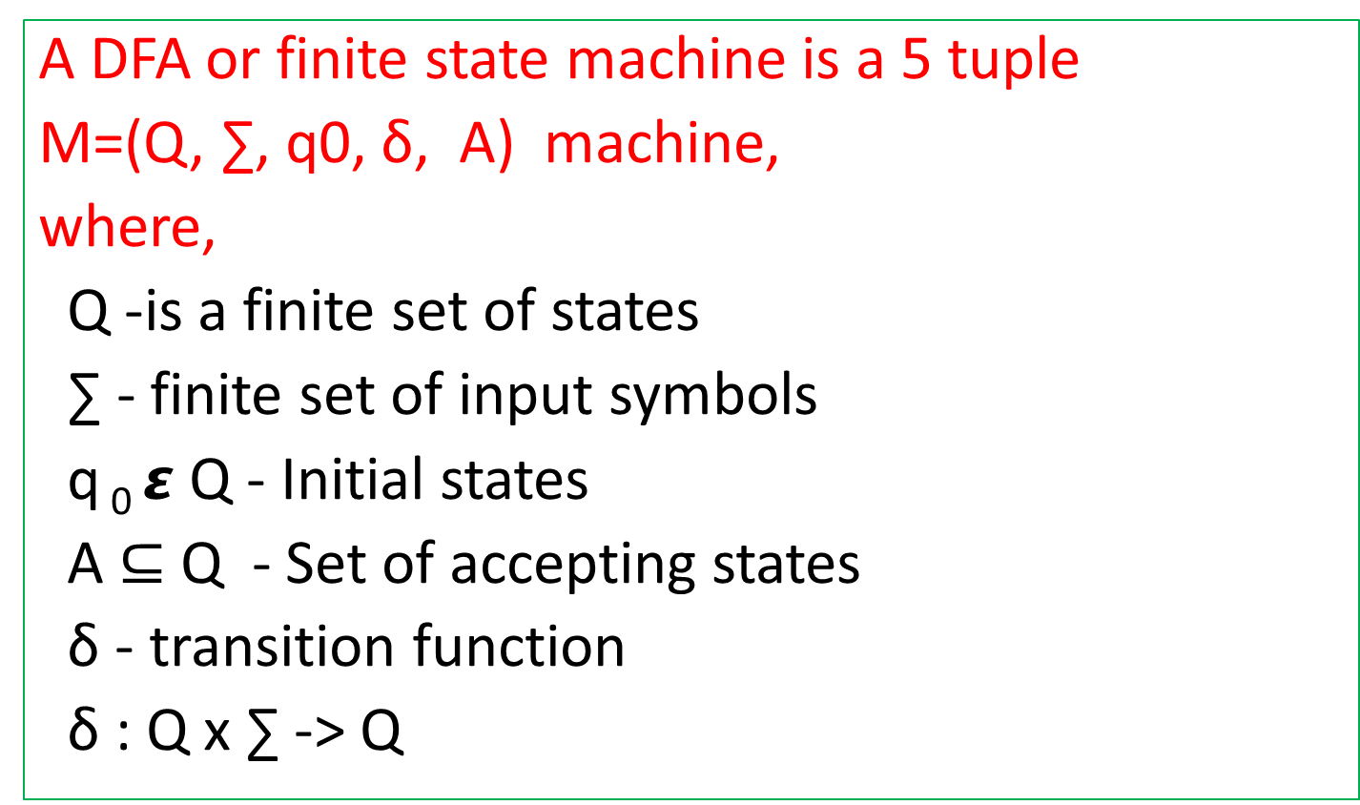
Formal Definition of DFA
A DFA or finite state machine is a 5 tuple
M=(Q, ∑, q0, δ, A) machine,
where,
Q -is a finite set of states
∑ - finite set of input symbols
q₀ $ε$ Q - Initial states
A ⊆ Q - Set of accepting states
δ - transition function
δ : Q x ∑ -> Q

Slide 19
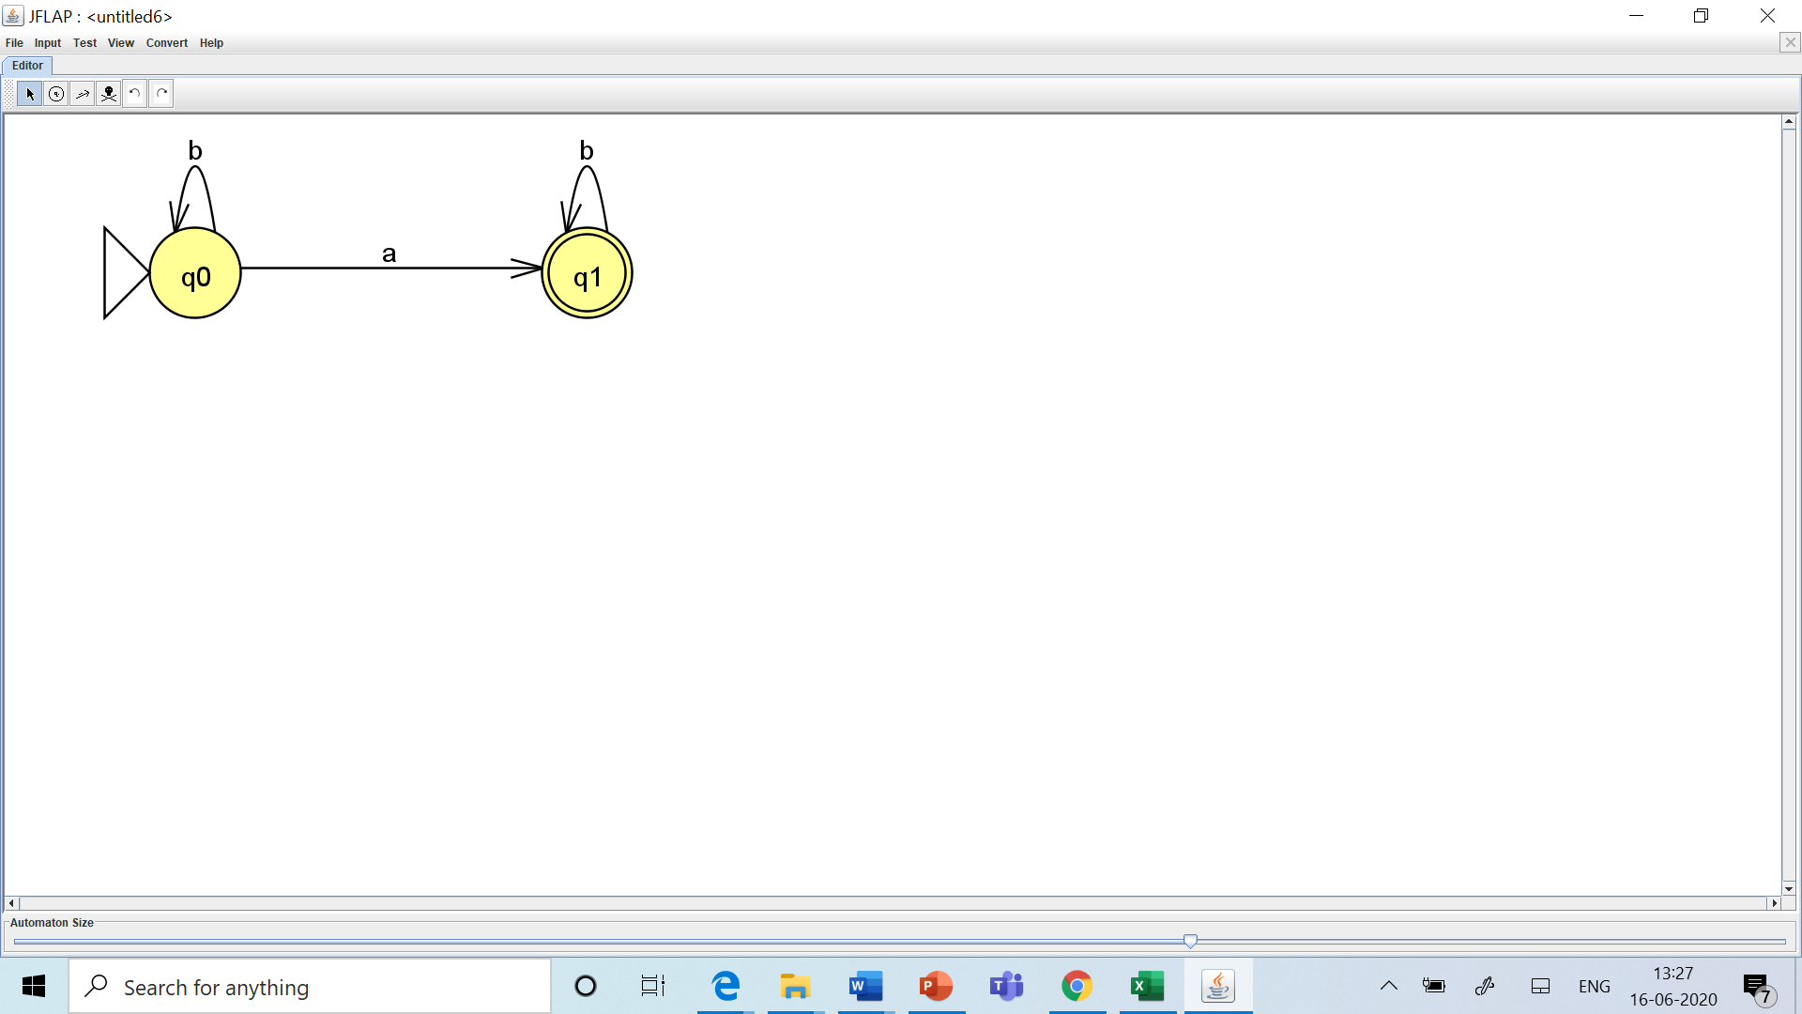
Construction of DFA
Problems:
1. Design DFA to accept the strings having exactly one a.
∑ ={ a,b}
w ={a,ab, ba, abb,bab ……..} RE = b*.a. b*
Tuples: DFA - State Diagram
Q={q0,q1}
∑={a,b}
q0 -> start state
A= {q1}
δ - transition function
δ (q0,a)->q1
δ (q0,b)->q0
δ (q1,a)-> null
δ (q1,b)-> q1
δ : Q x ∑ -> Q

Slide 20
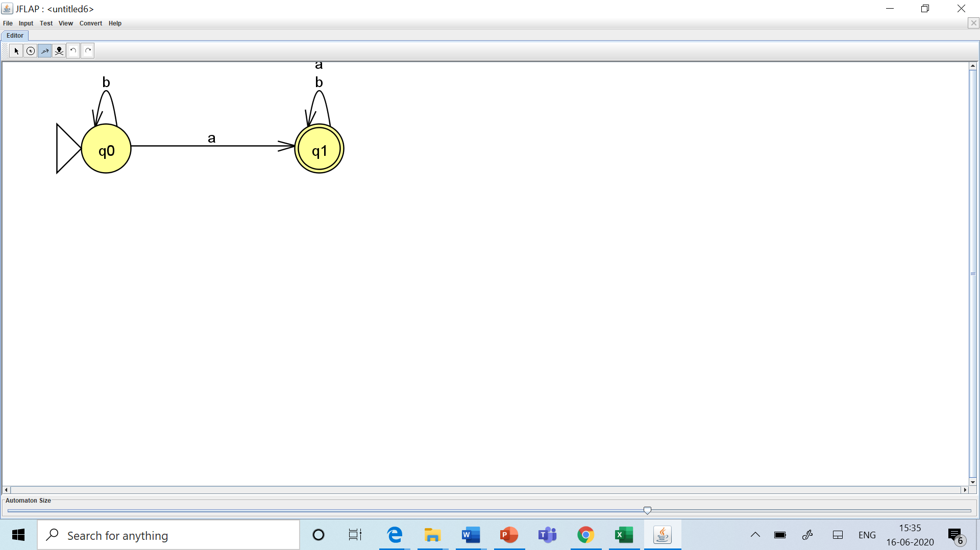
2. Design DFA to accept strings having at least one a.
∑ ={ a,b} w={ a, ab, ba, ….} RE = b*.a. (a+b)*
DFA- Diagram
Tuples:
Q={q0,q1}
∑={a,b}
q0 -> start state
A= {q1}
δ - transition function
δ (q0,a)->q1
δ (q0,b)->q0
δ (q1,a)-> q1
δ (q1,b)-> q1
δ : Q x ∑ -> Q

Slide 21
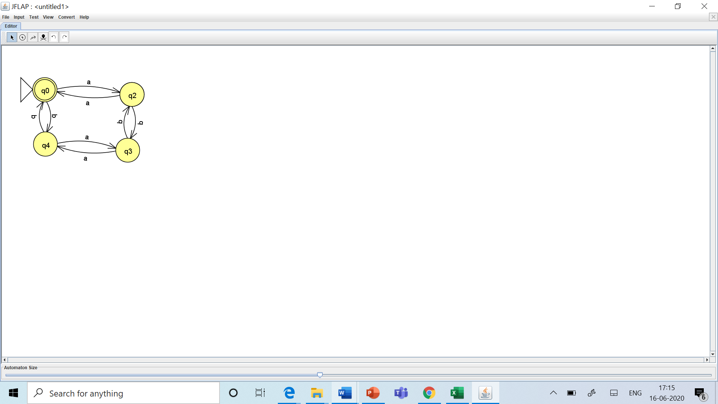
3. Design DFA to accept
Case 1: strings of even a’s and even b’s
Case 2: strings of even a’s and odd b’s
Case 3: strings of odd a’s and even b’s
Case 4: strings of odd a’s and odd b’s
Case 1: even -even
DFA Diagram:
W={Λ, aa,bb,abab,….}

Slide 22
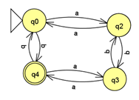
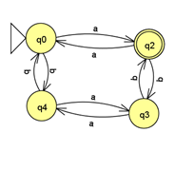
Case 2: even-odd
DFA Diagram
W={aab, aba,baa…}
Case 3: odd - even
DFA Diagram
W={abb,bab,bba…….}

Slide 23

Case 4: odd-odd
DFA Diagram
W={ ab, abbb,baaa…..}
Tuples:
Q={q0,q2,q3,q4}
Σ ={a,b}
q0= start state, A={q3}
Transition Function:
δ(q0,a)={q2}, δ(q0,b)={q4}
δ(q2,b)={q3}, δ(q2,a)={q0}
δ(q3,a}={q4}, δ(q3,b)={q2}
δ (q4,a)={q3}, δ(q4,b)={q0}

Slide 24
Extended Transition Function (δ*)
δ*
Describes what happens when we start in a any state and follow any sequence of inputs.
Definition of δ*:
Let M= (Q,Σ,δ,q0,A) be a FA.
We define the function δ* : Q x ∑ *->Q as follows:
1. For any state q ∈ Q , δ* (q, Λ ) = q
2. for any state q ∈ Q , y ∈ ∑ *, a ∈ ∑
δ*(q, ya) = δ(δ*( q,y),a)
Note:
δ* - to read a string
δ – to read a symbol

Slide 25
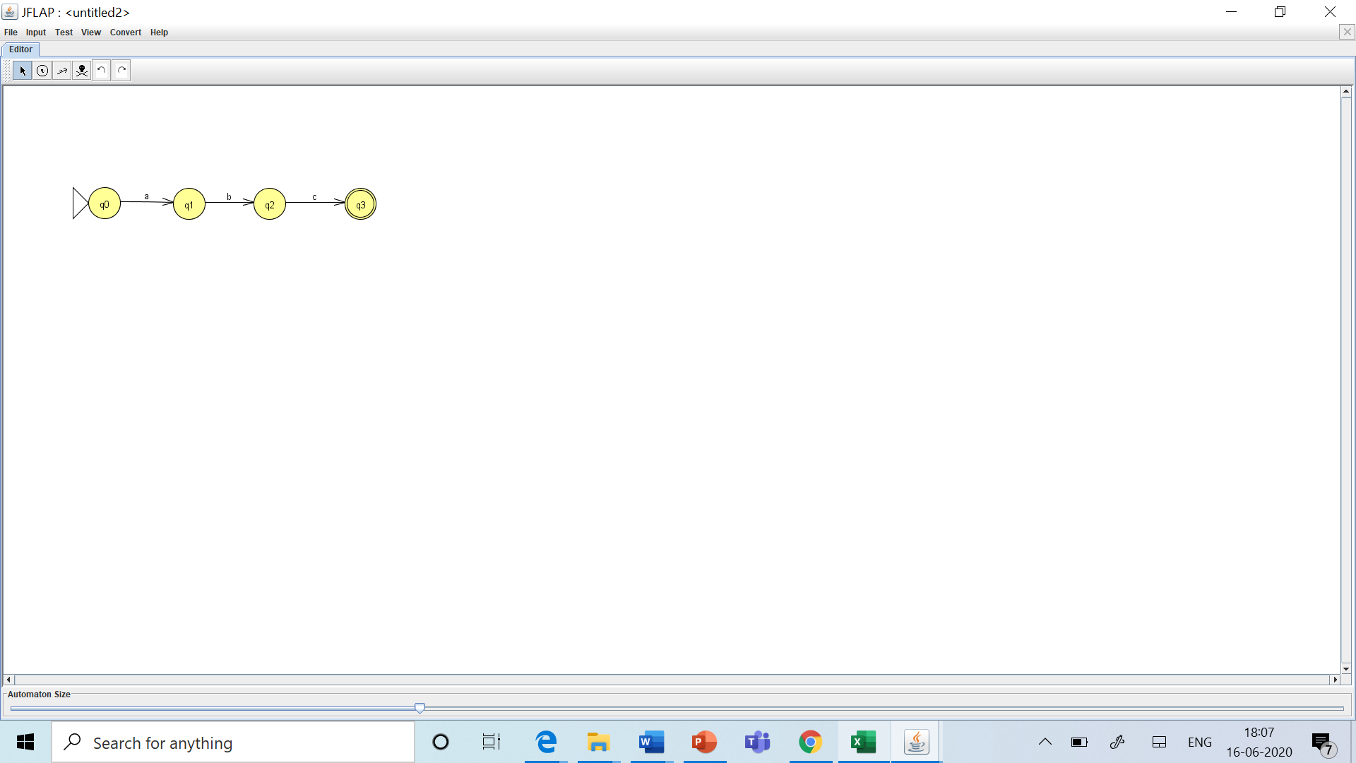
Problems - (δ*)
Find δ*(q0,abc) ?
δ* ( q0,abc) = δ(δ*(q0,ab),c)
= δ(δ(δ* (q0,a),b),c)
= δ(δ(δ (δ* (q0, Λ ),a),b),c)
= δ(δ(δ (q0,a),b),c)
= δ(δ(q1,b),c)
=δ(q2,c)
Ans= q3

Slide 26
Definitions
String acceptance by Finite Automata
Let M=(Q,∑,q0,A, δ) be an FA.
A string x∈ ∑* is accepted by M, if δ*( q0,x) ∈ A
Language acceptance by Finite Automata
The language accepted by M or the language recognized by M is the set,
L(M)= {x | x ∈ ∑* and δ*( q0,x) ∈ A}

Slide 27
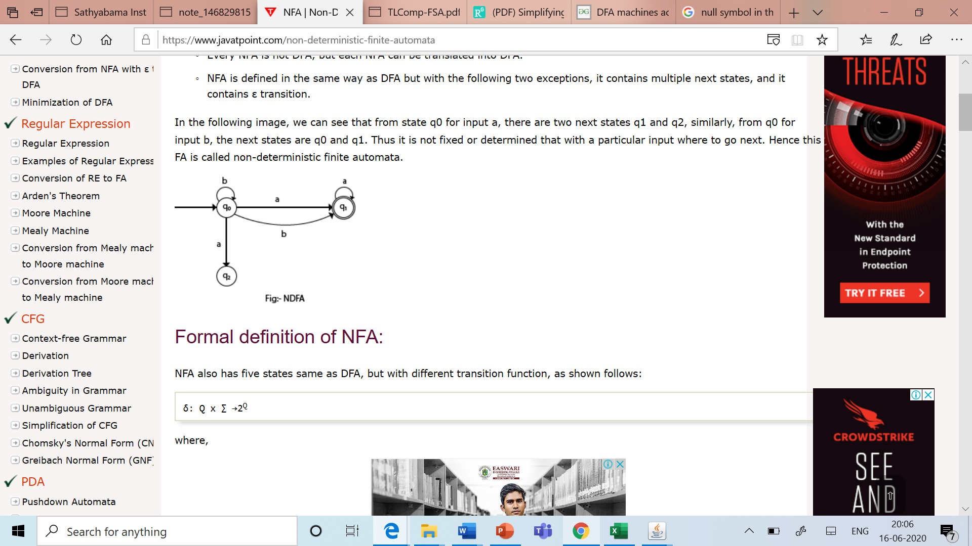
Non-Deterministic Finite Automata
When there exist many paths for specific input from the current state to the next state.
Every NFA is not DFA, but each NFA can be translated into DFA.
Types
1. NFA without Λ 2.
2. NFA with Λ
Advantages of NFA over DFA:
DFAs are faster but more complex
Build a FA representing the language that is a union, intersection, concatenation etc. of two (or more) languages easily by using NFA's.

Slide 28
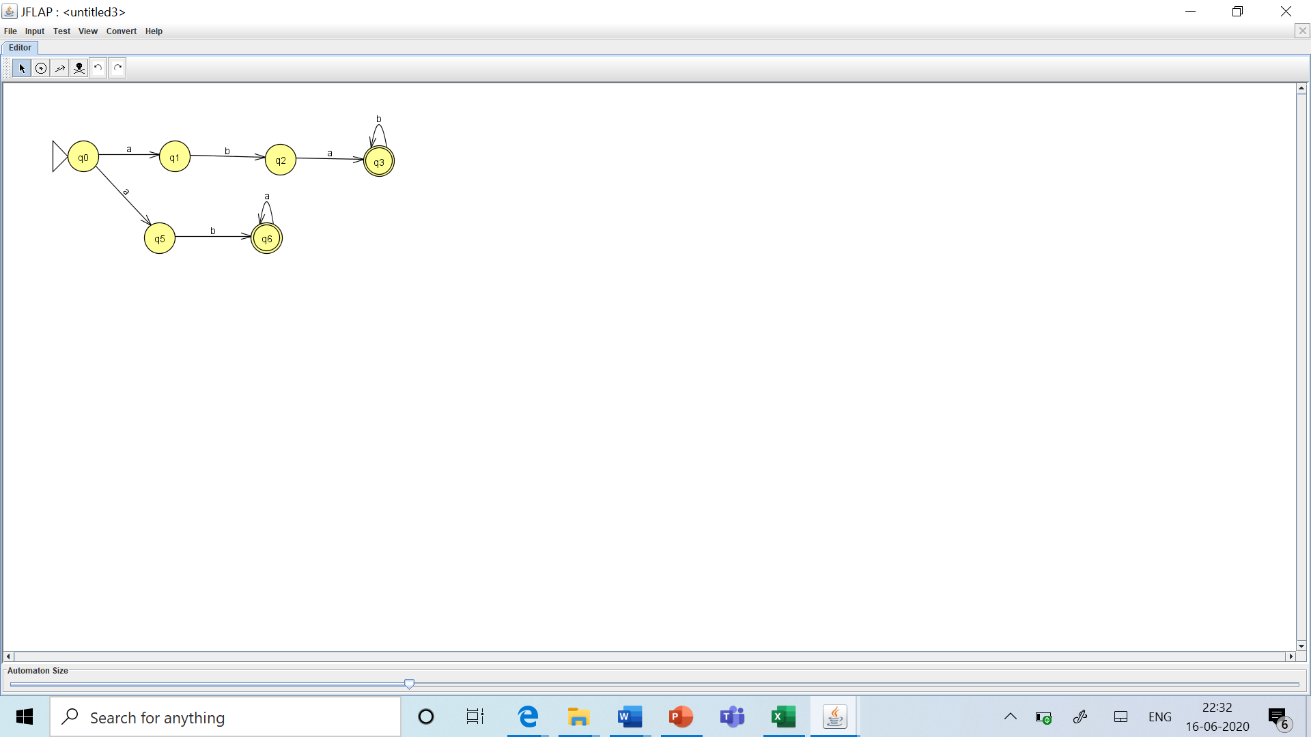
Design NFA to accept the Language
L= {w/w = abab^{n} /aba^{n}}
Q= {q0,q1,q2,q3,q5,q6} ∑ ={a,b} q0=start state
A={q3,q6}
Transition Function (δ ):
δ(q0,a)={q1,q5} etc

Slide 29
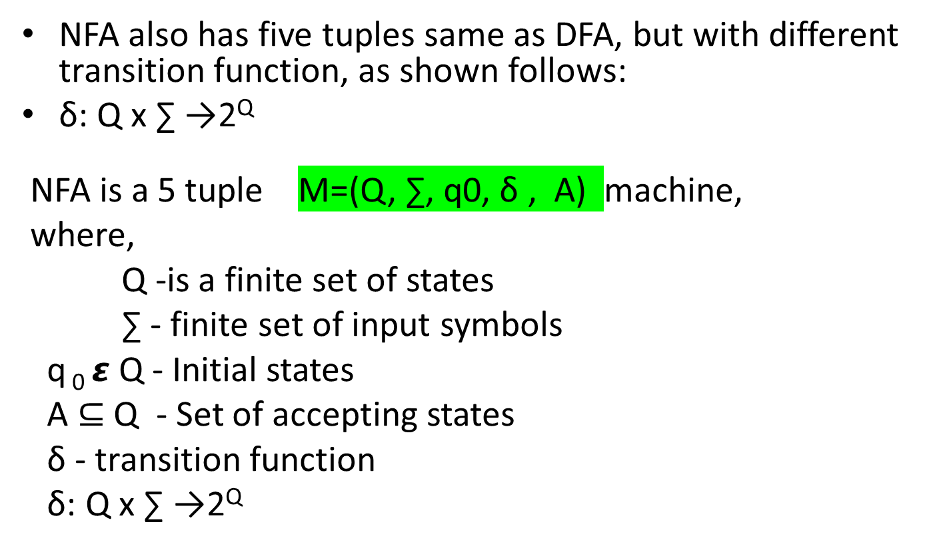
Formal definition of NFA

Slide 30
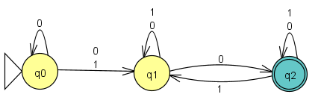
Conversion of NFA to DFA
Problem 1: convert the given NFA to DFA
For the given transition diagram ,first construct the transition table. NFA Transition Table
State | 0 | 1
q0 | {q0,q1} | {q1}
q1 | {q1,q2} | {q1}
q2 | {q2 } | {q1,q2}

Slide 31
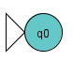
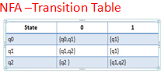
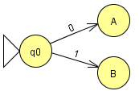
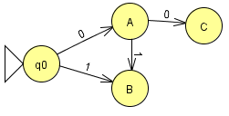
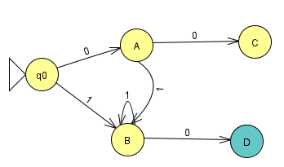
Step 1: Add q0 of NFA to DFA
Step 2: From the start state of q0 find the transitions
δ'([q0], 0) = [q0,q1] -------- (A )
δ'([q0], 1) = [q1] -----(B)
Step 3: Find the possible set of states for each input symbol
3.1 From A: DFA- Transition Table
δ'([q0, q1], 0) = δ(q0, 0) ∪ δ(q1, 0)
= {q0, q1} ∪ {q1,q2}
= {q0, q1, q2}
= [q0, q1, q2] --------(C)
δ'([q0, q1], 1) = δ(q0, 1) ∪ δ(q1, 1) DFA - State Diagram
= {q1} ∪ { q1}
= {q1}
= [q1] ------( B)
3.2 From B:
δ'([q1], 0) = [q1, q2]--------(D)
δ'([q1], 1) = [q1] ------------(B)
State | 0 | 1
q0 | A | B
A | C | B
B | D | B

Slide 32
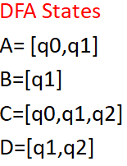
3.3 From C:
δ'([q0, q1, q2], 0) = δ(q0, 0) ∪ δ(q1, 0) ∪ δ(q2, 0)
= {q0, q1} ∪ {q1, q2} ∪ q2
= {q0, q1, q2}
= [q0, q1, q2] ----(C)
δ'([q0, q1,q2], 1) = δ(q0, 1) ∪ δ(q1, 1) ∪ δ(q2,1)
= {q1} ∪ { q1} ∪ {q1, q2}
= {q1, q2}
= [q1, q2] ------( D)
3.4 From D:
δ'([q1, q2], 0) = δ(q1, 0) ∪ δ(q2, 0)
= {q1, q2} ∪ q2
= [q1, q2]--------(D)
δ'([q1, q2], 1) = δ(q1, 1) ∪ δ(q2, 1)
= {q1} ∪ {q1, q2 }
= [q1, q2] ------------(D)
State | 0 | 1
q0 | A | B
A | C | B
B | D | B
C | C | D
D | D | D

Slide 33
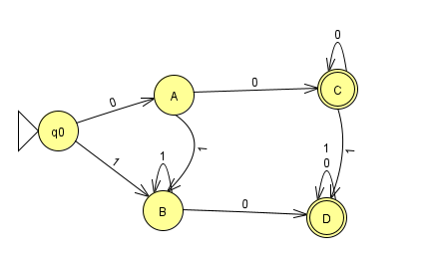
Final states of DFA
Final States : C and D
The state [q0,q1,q2…qn] ∈ Q (DFA) is the final state is atleast one of the states in
Transition Table State diagram – DFA
State | 0 | 1
q0 | A | B
A | C | B
B | D | B
C | C | D
D | D | D

Slide 34
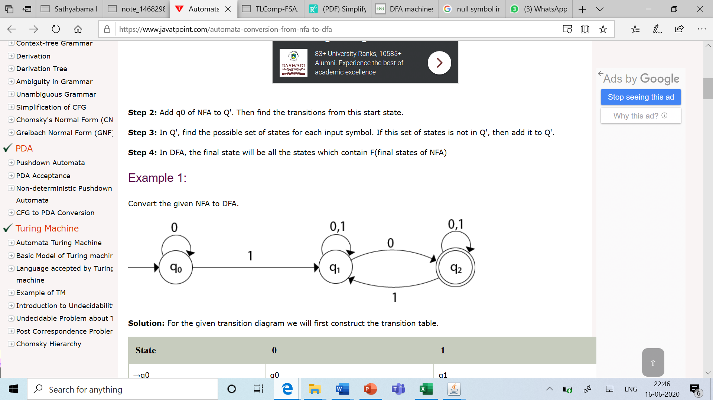
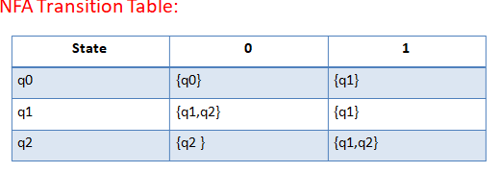
Conversion of NFA to DFA
Problem 1:
For the given transition diagram we will first construct the

Slide 35
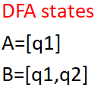
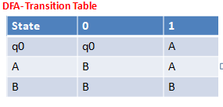
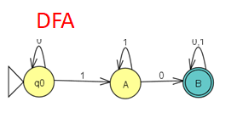
Step 1: Add q0 of NFA to DFA
Step 2: From the start state of q0 find the transitions
δ'([q0], 0) = [q0]
δ'([q0], 1) = [q1] -----(A)
Step 3: find the possible set of states for each input symbol
3.1 From A
δ'([q1], 0) = δ(q1, 0)
= [q1,q2 ] -------------(B)
δ'([q1], 1) = δ(q1, 1)
= [q1] --------------(A)
3.2 From B:
δ'([q1,q2], 0) = δ(q1,0) U δ(q2,0)
={q1,q2} U {q2}
={q1,q2} --------------(B)
δ'([q1,q2], 1) = δ(q1,1) U δ(q2,1)
={q1} U{q1,q2}
= [q1, q2] ------------(B)
Step 4: Final State = [B]

Slide 36
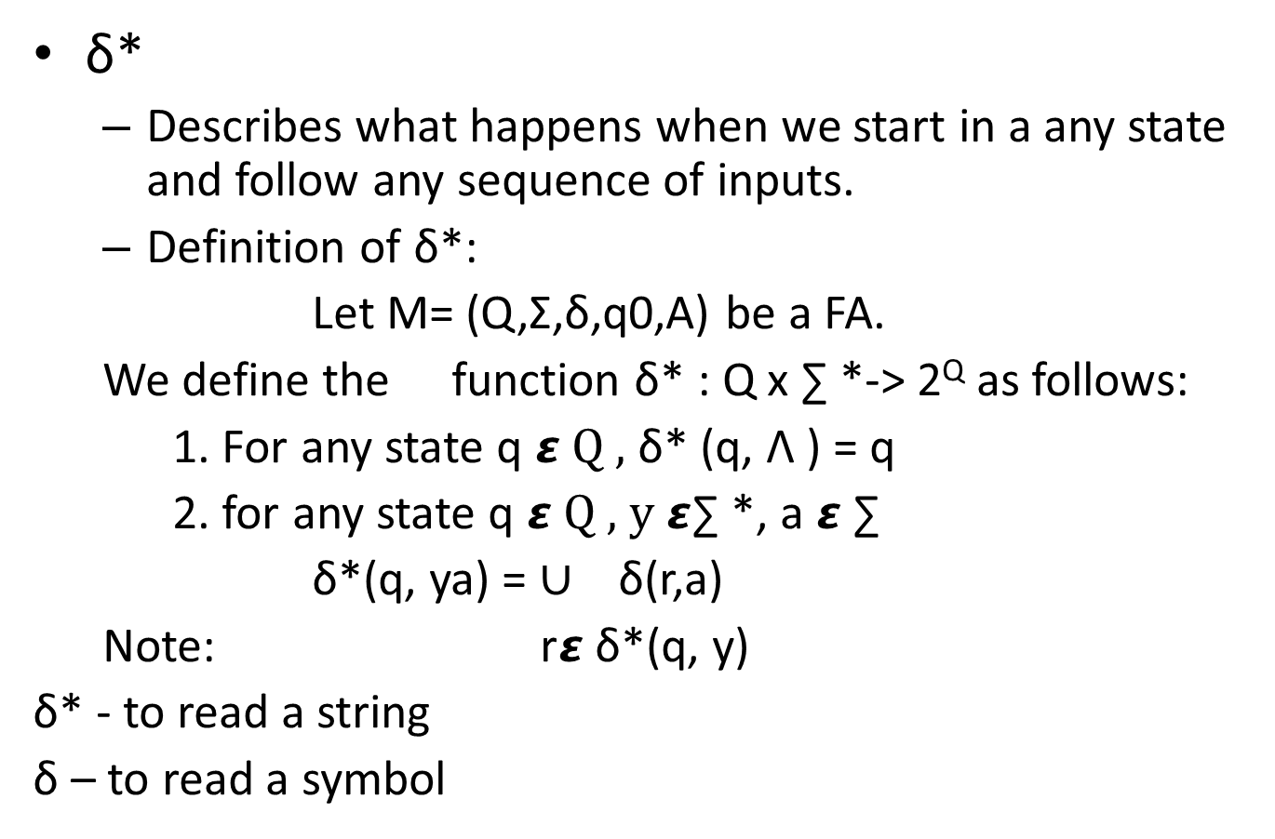
Extended Transition Function of NFA (δ*)

Slide 37
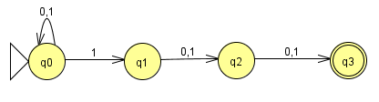
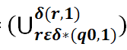
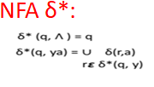
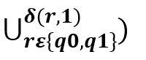
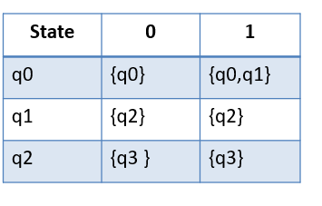
Find δ*(q0,11), δ*(q0,01), δ*(q0,011), δ*(q0,111) from the given NFA:
Find:
i. δ*(q0,11):
δ*(q0,11)=
= δ(q0,1) U δ(q1,1)
={q0,q1} U {q2}
={q0,q1,q2}

Slide 38
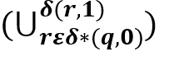
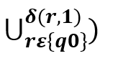
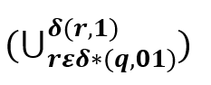
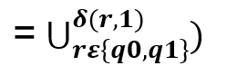
ii. Find δ*(q0,01)
δ*(q0,01)=
= δ(q0,1)
={q0,q1}
iii. Find δ*(q0,011)
δ*(q0,011)=
=δ(q0,1) U δ(q1,1)
={q0,q1} U{q2} ={q0,q1,q2}

Slide 39
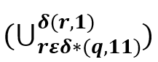
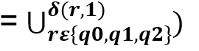
iv.Find: δ*(q0,111)
δ*(q0,111)=
=δ(q0,1) U δ(q1,1) U δ(q2,1)
= {q0,q1} U{q2}U{q3}
= {q0,q1,q2,q3}
∴111 is accepted.

Slide 40
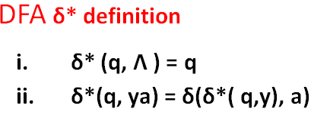
Theorem 1
Statement:
For any NFA machine M=(Q, ∑, q0, δ , A) accepting a language L ⊆ ∑*, there is a DFA machine M1= (Q, ∑, q0, δ , A) that accepts L.

Slide 41
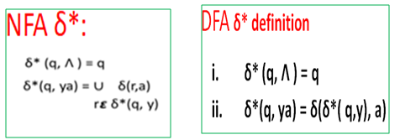
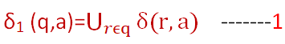
Proof by Structural Induction
Proof:
DFA- M₁is defined as follows:
Q₁=2^{Q}
q₁=q₀
A₁={qϵQ₁ |A⊆Q}
For,qϵQ₁ and aϵ∑,
To prove, δ₁*(q₁,x)= δ*(q₀,x)
M₁accepts the same language as M

Slide 42
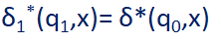
Proof by Structural Induction:
1.Basis Step
Strings of length 0
If x=ꓥ,
LHS = δ₁*(q₁,x) = δ₁*(q₁,ꓥ)
= q₁------- (By definition of δ₁*)
= {q₀} ------- (By definition of q₁)
= δ*(q₀,ꓥ)------- (By definition of δ*)
= δ*(q₀,x) = RHS
2.Induction Hypothesis:
Assume the statement to be proved is true.
x is a string satisfying,

Slide 43
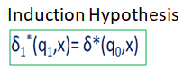
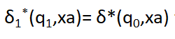
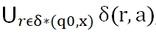
3.Induction Step:
To prove, for any aϵ∑, xϵ∑*
to be proved
LHS=δ₁*(q₁,xa)=δ₁(δ₁*(q₁,x),a) ------- (By definition of δ₁*)
= δ₁(δ*(q₀,x),a) -------(By Induction Hypothesis)
= -------(By 1)
=δ*(q₀,xa) =RHS------- (By definition of δ*)
Hence Proved.

Slide 44
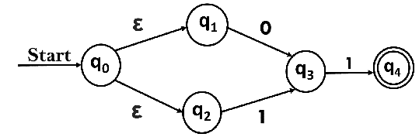
NFA – with Λ Transition
This allows transitions not only input symbols but also on null inputs.
Ʌ or ε (EPSILON )Empty string does not do any operation.
aɅ=a | oɅ=0 |1Ʌ = 1

Slide 45
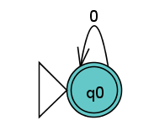
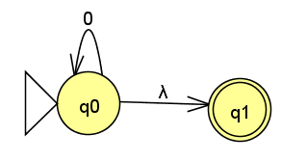
NFA-with Λ Transitions
Example:
RE=0*
NFA without NULL
NFA with NULL

Slide 46



Formal definition of NFA with Λ
NFA -Λ also has five tuples same as NFA, but with different transition function, as shown follows:
NFA - Λ is a 5 tuple M=(Q, ∑, q0, δ , A) machine,
where,
Q -is a finite set of states
∑ - finite set of input symbols
q₀ $ε$ Q - Initial states
A ⊆ Q - Set of accepting states
δ - transition function
δ: Q x ∑ $∪${Λ }→2^{Q}

Slide 47
Epsilon (NULL) Closure of a state -Λ(q)
Λ(q) of a set of states can be defined as follows:
It is a set of all states that can be reached from any state on Λ symbol
Let M=(Q, ∑, q0, δ , A) be a NFA- Λ machine and let S be any subset of Q.
The Λ(S) is the set defined as follows:
1. Every element of S is in element of Λ(S)
2. For any q 𝞮 Λ(S), every element of
δ(q, Λ) is in Λ(S)

Slide 48



Problems on Ʌ Closure
1.
Ʌ(q0)={ }
Ʌ(q1) ={ }
Ʌ(q2)={ }

Slide 49

Problems on Ʌ Closure
2.
Ʌ(q0)={ }
Ʌ(q1) ={ }
Ʌ(q2)={ }

Slide 50

Extended Transition Function of NFA- Λ (δ*)
δ*
Describes what happens when we start in a any state and follow any sequence of inputs.
Definition of δ*:
Let M= (Q,Σ,δ,q0,A) be a NFA with Λ .
We define the function δ* : Q x ∑ * {Λ }→2^{Q} as follows:
1. For any state q 𝞮 Q , δ* (q, Λ ) = Λ (q)
2. for any state q 𝞮 Q , y 𝞮∑ *, a 𝞮 ∑
δ*(q, ya)
δ* - to read a string
δ – to read a symbol

Slide 51

Extended Transition Function (δ*)

Slide 52

Problem on δ*
i.Find δ*(q0,Ʌ) = Ʌ({q0})
δ*(q0,Ʌ) = {q0,p,t}

Slide 53



ii.Find δ*(q0,0)
δ*(q0,Ʌ0)
=Ʌ(δ(q0,0) U δ(p,0) U δ(t,0))
=Ʌ(∅ U{P}U{u})
= Ʌ({p,u})
={p,u}

Slide 54



ii.Find δ*(q0,01)
δ*(q0,01)
=Ʌ(δ(p,1) U δ(u,1))
=Ʌ({r}U∅)
= Ʌ({r})
δ*(q0,01) ={r}

Slide 55



iii.Find δ*(q0,010)
δ*(q0,010)
=Ʌ(δ(r,0))
= Ʌ({s})
={s,w,q0,p,t}
Accepted

Slide 56


Conversion of NFA-Ʌ to an NFA
Find Ʌ-closure of all states
Ʌ-closure(A)
={A,B,D}
Ʌ-closure(B)
={B,D}
Ʌ-closure(C)
={C}
Ʌ-closure(D)
={D}

Slide 57







Find δ* for all the states:
δ*(A,0)=δ*(A,Ʌ0)
=Ʌ(δ(A,0) U δ(B,0) U δ(D,0))
=Ʌ(A,C,D)
={A,B,C,D}
ii. δ*(A,1)=δ*(A,Ʌ1)
=Ʌ(δ(A,1) U δ(B,1) U δ(D,1)) = Ʌ(∅) =∅

Slide 58




iii. δ*(B,0)=δ*(B,Ʌ0)
=Ʌ(δ(B,0) U δ(D,0))
= Ʌ(C,D)
={C,D}

Slide 59



iv. δ*(B,1)=δ*(B,Ʌ1)
=Ʌ(δ(B,1) U δ(D,1))
= Ʌ(∅)
=∅

Slide 60







v.δ*(C,0)=δ*(C,Ʌ0)
=Ʌ(δ(C,0))= Ʌ(∅)=∅
vi. δ*(C,1)=δ*(C,Ʌ1)
=Ʌ(δ(C,1)) =Ʌ(B)= {B,D}

Slide 61







vii. δ*(D,0)=δ*(D,Ʌ0)
=Ʌ(δ(D,0))=Ʌ(D)={D}
viii.δ*(D,1)= δ*(D,Ʌ1)
=Ʌ(δ(D,1)) = Ʌ(∅) =∅

Slide 62


Final state of NFA
Final state of NFA and NFA-Ʌ are same,
If initial state Ʌ(A)={A,B,D} has NFA-Ʌ final state then initial state A is also final state.
Given NFA- Ʌ NFA

Slide 63

Conversion of NFA-Ʌ to an NFA
Problem-2 GIVEN NFA-Ʌ
Ʌ -Closure (A)=
{A,B,D}
Ʌ -Closure (B)=
{B} CONVERTED NFA
Ʌ -Closure (C)=
{C}
Ʌ -Closure (D)=
{D}
Ʌ -Closure (E)=
{E}
State | 0 | 1
A | {A,B,C,D,E} | {D,E}
B | {C} | {E}
C | - | {B}
D | {E} | {D}
E | - | -

Slide 64
Theorem 2
Equivalence of NFA-ꓥ and NFA
If L is accepted by an NFA with ꓥ transitions then L is accepted by NFA without ꓥ transitions
Statement:
For any NFA NULL machine M=(Q, ∑, q0, δ , A) accepting a language L ⊆ ∑*, there is a NFA machine M1= (Q, ∑, q0, δ , A) that accepts L.
Given:
NFA-ꓥ, M=(Q,∑,δ,q0,A)
NFA, M1=(Q1,∑,δ1,q1,A1)

Slide 65




Given:
NFA-ꓥ, M=(Q,∑,δ,q0,A) NFA-ꓥ:
NFA, M1=(Q1,∑,δ1,q1,A1)
Proof: NFA:
By Definitions:
For, aϵ∑ :
(By definition it is true if we
pass a single length string)
To Prove:

Slide 66




Proof: By Structural Induction
Basis Step:
Take |x|=0 => x= Ʌ
LHS:
RHS:
So the above statement is not true for |x|=ꓥ
Hence we begin the induction with |x|=1
Let, x=a
(By definition it is true if we pass a single length string)

Slide 67





Induction Hypothesis: Assumption:
x is a string satisfying: δ₁*(q₁,x)= δ*(q₀,x)
Induction Step
To prove, for any aϵ∑, x ϵ∑*
δ₁*(q₁,xa)= δ*(q₀,xa)
LHS: δ₁*(q₁,xa)
----(By Induction Hypothesis)
( δ=δ1 if the length of the string is 1)
=
= δ*(q, xa)
=RHS Hence the theorem is proved.

Slide 68
Kleene’s Theorem Part -I
For any regular expression r that represents language L(r), there is a finite automaton that accepts that same language.
For any finite automaton M that accepts language L(M), there is a regular expression that represents the same language.

Slide 69
Regular Expressions to NFA -Ʌ Kleene’s Theorem Part-I:
For each kind of RE, define an NFA.
Input: A Regular Expression r over an alphabet ∑
Output: An NFA N accepting L(r)
Method:
Step 1: For ε
The NFA recognizes {ε}
Step 2: For a in ∑
The NFA recognizes {a}
start
ε
i
f
start
a
i
f

Slide 70
Regular Expressions to NFA- Ʌ
Step 3: RE=a |b
The NFA recognizes {a,b}
Step 4: RE=ab
OR
The NFA recognizes {ab}
a
1
2
ε
ε
start
0
5
ε
ε
3
4
b
start
a
b
start
a
ε
b
0
1
2
0
1
2
3

Slide 71
Kleene’s Theorem Part-I:
Step 5: RE=a*
The NFA recognizes {ε,a,aa,aaa,.......}
Step 6: RE= a⁺
= a.a*
Follow step 4 for construction.
ε
start
ε
a
ε
0
1
2
3
ε

Slide 72

Converting RE to NFA-Ʌ

Slide 73
Problem 1
Construct Non deterministic Finite Automata with NULL transition or the following regular expression using Kleene’s Theorem Part-I: method.
(a|b)*abb
(a|b)*
(a*|b*)* =a*,b* , (a*+b*)
((ε|a)b*)*
(0|123)*=0,123,0+123,

Slide 74
Example 1
Decomposition of (a|b)*abb
r₁₁
start
a
0
1
r₉
r₁₀
start
b
r₇
2
3
r₈
r₅
b
a
r₆
b
1
2
r₄
*
ε
ε
a
start
(
r₃
)
0
5
r₁
r₂
ε
ε
|
3
4
b
a
b

Slide 75
Example 1(contd.)
Decomposition of (a|b)*abb
r₁₁
r₉
ε
r₁₀
r₇
a
r₈
2
3
r₅
b
ε
start
ε
ε
r₆
b
0
1
ε
r₄
*
6
7
a
ε
ε
(
)
4
5
r₃
b
r₁
|
r₂
ε
a
b

Slide 76
Example 1(contd.)
Decomposition of (a|b)*abb
r₁₁
r₉
ε
r₁₀
r₇
a
r₈
2
3
r₅
b
ε
start
ε
ε
a
r₆
b
0
1
ε
r₄
*
6
7
8
a
ε
ε
(
)
4
5
r₃
b
r₁
|
r₂
ε
a
b

Slide 77
NFA- Ʌ for (a|b)*abb
ε
a
2
3
ε
ε
start
0
ε
1
ε
a
b
b
6
7
8
9
10
ε
ε
4
5
b
ε

Slide 78
Assignment
Construct Non deterministic Finite Automata with NULL transition or the following regular expression using Kleene’s Theorem Part-I: method.
(a|b)*abb
(a|b)*
(a*|b*)*
((ε) |a)b*)*= ε,a, ε+a,b*, , (ε+a)b*,
(0|123)*

Slide 79
Kleene’s Theorem Part-I:
Statement:
Any RL can be accepted by a FA.
Or
Let ‘r’ be a RE, then there exists an NFA with Ʌ transitions that accepts L(r).
Proof:
By induction on the number of operators in the RE ‘r’ that there is an NFA ‘M’ with Ʌ-transitions having one final state, and no transitions out of this final state,
such that L(M)=L(r).

Slide 80



Basis Step: ‘r’ has ∅ operators
‘r’ must be
The NFA-Ʌ for ‘r’ are
r=Φ r=Ʌ r=’a’
Induction Hypothesis:
Assume that theorem is true for ‘r’ with fewer than ‘i’ operators, i>=1 =>1<=n<i

Slide 81


Induction Step:
Let ‘r’ have ‘i’ operators.
Case 1: r=r1+r2
Let NFA-Ʌ Machine
M₁=(Q₁,∑₁,δ₁,q₁, {f1})
L(M₁)=L(r₁)
Let NFA- Ʌ’s machine
M₂=(Q₂,∑₂,δ₂,q₂,{f2})
L(M₂)=L(r₂)
Where Q1 and Q2 are disjoint.
q0->new initial state
f0->new final state
Construct M= (Q1UQ2U{q0,f0}, ∑₁U∑₂,δ,q0,{f0})

Slide 82
Where δ is defined by,
δ(q0,Ʌ)={q1,q2}
δ(q,a)=δ₁(q,a) for q in Q₁-{f1} & a in ∑₁U{Ʌ}
δ(q,a)=δ₂(q,a) for q in Q₂-{f2} & a in ∑₂U{Ʌ}
δ(f1,Ʌ)=δ(f2,Ʌ)={f0}
Thus all the moves of M1 and M2 are in M.
There is a path labelled x in M from q1
to f1 or a path in M2 from q2 to f2.
Hence L(M)=L(M1) U L(M2)
L(M)={x|x is in L(M1) or x is in L(M2)}

Slide 83


Case 2: r=r1 . r2
Let M1 and M2 be as in case 1
Construct M=(Q1UQ2,∑1U∑2,δ, {q1}, {f1})
Where δ is defined by,
δ(q,a)=δ₁(q,a) for q in Q₁-{f1} &a in ∑₁U{Ʌ}
δ(f1,Ʌ)={q2}
δ(q,a)=δ₂(q,a) for q in Q₂-{f2} & a in ∑₂U{Ʌ}
Hence
Every path in M from q1 to f2 is a path labelled by some string x from q1to f1 followed by the edge from f1 to q2 labelled Ʌ followed by a path labelled by some string ‘y’ from q2 to f2.
L(M)=L(M1) . L(M2)

Slide 84


Case 3:r =r₁*
Let M₁=(Q₁,∑₁,δ₁,q₁,{f1}) & L(M₁)=L(r₁)
Construct M= (Q1U{q0,f0}, ∑₁,δ₁,q0,{f0})
Where δ is defined by
δ(q0,Ʌ)=δ(f1,Ʌ) = {q1,f0}
δ(q,a)=δ₁(q,a) for q in Q₁-{f1} & a in ∑₁U{Ʌ}
Any path from q0 to f0 consists either of a path from q0 to f0 on Ʌ or a path from q0 to q1 on Ʌ, followed by some number of paths from q1 to f1, then back to q1 on Ʌ, each labelled by a string in L(M1) followed by a path from q1 to f1 on a string in L(M1).
Hence L(M)= L(M1)*
Hence any RL can be accepted by a NFA is proved.

Slide 85

Kleene’s Theorem Part -II
Any language accepted by a finite automaton is regular.

Slide 86


Conversion of DFA to Regular Expression
Formula:
Where
i= Start state
j = Final state
k = No.of states

Slide 87


Problem 1: Obtain the regular expression for the finite automata shown below:
Formula for RE:
Step 1: Rename the states:

Slide 88





Step 2: Find the values of i,j,k
i=1 (start state)
j=2 (final state)
k=2 (no. of states)
Substitute I,j,k in formula:
Find:

Slide 89






In:
When K=0:
Substitute in equation 2 and 3:

Slide 90





Substitute in equation 3:
When K=0:
Substituting in 1:

Slide 91





Substituting in 1:

Slide 92

2. Obtain the RE for the following DFA

